Slide 1
World Perception System
Internal Interfaces
6/4/2020
- 1 -

Slide 2
WPS Goal
Two main goals:
Build database of 3d models.
Use those 3d models in order to determine location
6/4/2020
- 2 -

Slide 3
Main Requirements Summary
Req | Name and link | Demo plan
1 | Build Sparse/Dense Model | 2.3/2.1
2 | Drone Localization Reporting | 2.2
3 | UTM Center of frame | 2.4
4 | Vehicle Tracking | 2.4
5 | Display difference between two models
Note that the demo plan is summarized on a document
called: תכנית הדגמה להשקפת עולם
6/4/2020
- 3 -

Slide 4
Requirement: Req:1. Build Sparse/Dense Model
Build model of region of mission (RoM) upon user request based on pre-recorded video. Output sparse/full model
Input:
Video + Camera Localization
Last WPS Model
Last RoM ortophoto
Output:
WPS Model
Abort build model upon user request
Report progress of model building and model quality
6/4/2020
- 4 -

Slide 5
Build sparse/Dense model
This function is offline
The interface will be websocket
IAI-SG requests Algo to build model:
Parameters
ROM
Directory including the needed data
SighTec Algo reports the progress and the model quality
At the end of the process, the model is in the same directory with another name
6/4/2020
- 5 -

Slide 6
Build sparse/dense model details
When SighTec Algo module wake up, it should create the websocket.
SighTec Algo module should be the server because it provides a service.
IAI-SG connects to the websocket: ws://ip:9090
IAI-SG sends request to build model:
BuildModel
(ROM: (Point1, Point2, Point3,…),
“Path to the directory including the needed data”)
IAI-SG listens to messages reporting progress and the model quality
At the end of the process, the model is in the same directory with another name
All the names should start with a timestamp
For example:
The directory including data: 2021-01-01-01-12:00:00-DIR
The video 2021-01-01-12:00:00-Video.h264
The metadata 2021-01-01-12:00:00-Meta.txt
The orthophoto 2020-11-11-12:00:00-ortho.tbd
The last model 2021-10-09-12:00:00-model.tbd
The new model 2021-01-01-12:00:00-model.tbd
6/4/2020
- 6 -

Slide 7
Req:2. Drone Localization Reporting
Report drone position:
Input:
Last WPS Model
Last RoM orthophoto
Video Stream
Output:
Localization of the drone as data in a file
Stop reporting localization upon user request
6/4/2020
- 7 -

Slide 8
Report Drone Localization control
This function needs online video
The goal is to start reporting localization of drone 6DOF (in a file)
IAI-SG retrieves the right orthophoto + last model
There are two options:
Pipeline option:
IAI-SG creates relevant gstreamer pipeline with the SighTec algo plugin
SighTec algo starts reporting relevant localization
When the user cancels the function, IAI-SG deletes the pipeline.
Semi offline option:
IAI-SG connects to the websocket: ws://ip:9090
IAI-SG sends request to report drone localization:
ReportDroneLocalization(
“RTP Stream”
“Path to the directory including the needed data”)
When the user stops the activity, a file including the reported data is in the directory including the needed data.
6/4/2020
- 8 -

Slide 9
Drone Localization pipeline
Path to the directory including the needed data
Sight Tec Drone 6DOF Plugin
FileSink
RTSPSRC
RTSPSRC and FileSink are existing Gstreamer Plugins
SighTec should develop Drone 6DoFs Gstreamer plugin
Additional Parameters: location on the file system of the WPS model and orthophoto
6/4/2020
- 9 -

Slide 10
Req:3. UTM Center of frame
Upon request: one time
Report UTM coordinates of the center of frame:
Input:
Camera Localization
Last RoM ortophoto
Last WPS Model (?)
Video Stream
Output:
UTM Coordinates of center of frame(s)
Current linked frame
6/4/2020
- 10 -

Slide 11
Report UTM coordinates
This function needs online video and online 6 dofs
IAI-SG retrieves the right orthophoto + last model
IAI-SG creates relevant gstreamer pipeline
SighTec algo starts to dock the current video with the orthophoto
SighTec will report:
Status of docking
UTM coordinates of center of frame
Timestamps of the involved frames
IAI-SG deletes pipeline
6/4/2020
- 11 -

Slide 12
Report UTM coordinates pipeline
Path to the directory with the needed data
Publish
UTM Coordinates
Sink
Sight Tec FrameCenter UTM Plugin
RTSPSRC
Involved Frame
FileSink
PosOrientSrc
Docking status
RTSPSRC, Tee, FileSrc and FileSink are existing Gstreamer Plugins
SighTec should develop FrameCenter Gstreamer plugin
IAI-SG should develop PosOrientSrc and PublishUTMCoordinates Gstreamer plugins
Additional Parameters: location on the file system of the WPS model and orthophoto
State to report: docking status
6/4/2020
- 12 -

Slide 13
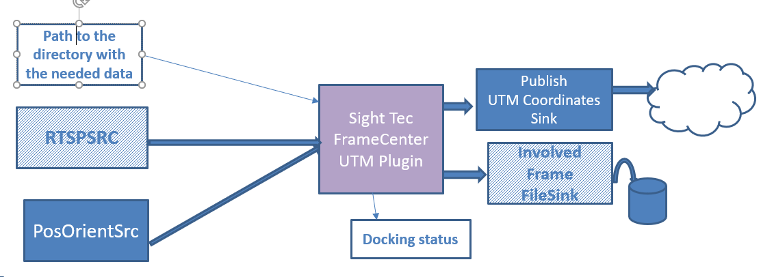
Report UTM coordinates
Pipeline details:
PosOrientSrc Plugin: connects to the video and retrieves the metadata and serves it as follows:
Timestamp, 6 dofs
Rate to determine
Path to the directory with the needed data is a parameter inserted at pipeline creation
RTPSRC Plugin output the video with RTP.
Publish UTM Coordinates Sink Plugin: connects to the FrameCenter Plugin and gets the coordinates. No definition yet what to do with them
The involved frame FileSink plugin with the location of the path of the needed data will be used to save the file containing the timestamp of the involved frames
The way the docking status will be reported in not defined yet
The main plugin is the FrameCenter UTM one that gets a path for the needed data at creation.

Slide 14
Req:4. Vehicle Localization
Upon request
Identify the vehicle and reports its localization, UTM + Azimuth:
Input:
Last WPS Model
Last RoM ortophoto
Camera Localization (or info to deduct it)
Reporting frequency
Video Stream
Deducted: Center of current frame
Output:
Localization of the vehicle: vehicle UTM + Azimuth
Current linked frame(s)
Stop reporting localization upon user request
6/4/2020
- 14 -

Slide 15
Report Vehicle Localization
This function needs online video and online 6 dofs
IAI-SG retrieves the right orthophoto + last model
IAI-SG creates relevant gstreamer pipeline
SighTec algo starts to dock the current video with the orthophoto
SighTec will report:
Status of docking
Azimuth and coordinates of vehicle
Timestamps of the involved frames
IAI-SG deletes pipeline eventually.
6/4/2020
- 15 -

Slide 16
Report Vehicle Localization pipeline
Frequency
Path to the directory with the needed data
Publish
UTM + Azimuth
Sink
Sight Tec Vehicle UTM + Azimuth Plugin
RTSPSRC
Involved Frame
FileSink
PosOrientSrc
Docking status
RTSPSRC, FileSrc and FileSink are existing Gstreamer Plugins
SighTec should develop UTMAzimuthVehicle Gstreamer plugin
IAI-SG should develop PosOrientSrc and PublishUTMAzimuthVehicle Gstreamer plugins
Additional Parameters: location on the file system of the WPS model and orthophoto
State to report: docking status
6/4/2020
- 16 -

Slide 17
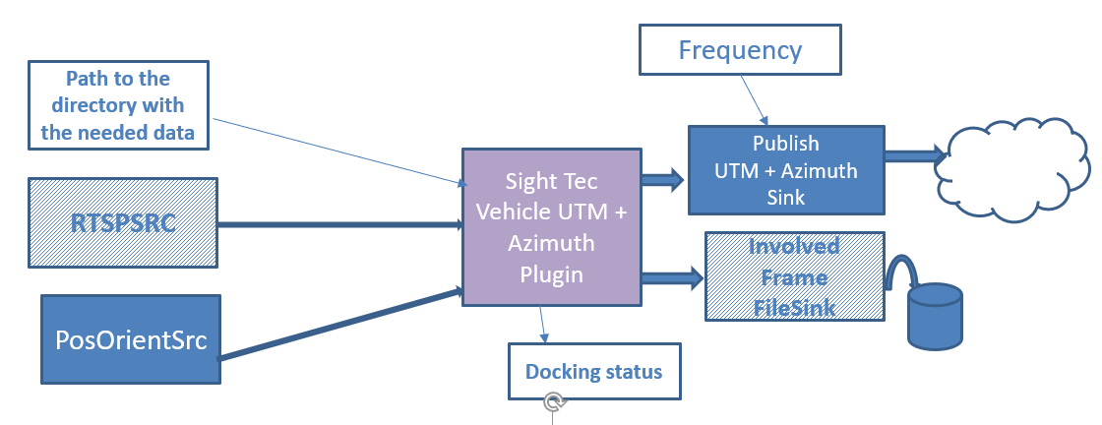
Report Vehicle Localization coordinates
Pipeline details:
PosOrientSrc Plugin: connects to the video and retrieves the metadata and serves it as follows: Timestamp, 6 dofs, Rate to determine
RTPSRC Plugin output the video with RTP.
Path to the directory with the needed data is a parameter inserted at pipeline creation
Publish UTM – Azimuth Coordinates Sink Plugin: connects to the UTMAzimuth Plugin and gets the coordinates. No definition yet what to do with them
The involved frame FileSink plugin with the location of the path of the needed data will be used to save the file containing the timestamp of the involved frames
The way the docking status will be reported in not defined yet
The main plugin is the UTMAzimuthVehicle one that gets a path for the needed data at creation.

Slide 18
Req:5. Display Differences
Online display model changes
Identify the changes since the last model:
Input:
Last WPS Model
Last RoM ortophoto
Camera Localization (or info to deduct it)
Video Stream
Output:
Model of the changes
Stop reporting model changes
6/4/2020
- 18 -

Slide 19
Display model changes pipeline
Path to the directory with the needed data
ModelChange
RTSPSRC
ModelChange
FileSink
PosOrientSrc
Docking status
RTSPSRC, FileSrc and FileSink are existing Gstreamer Plugins
SighTec should develop ModelChange Gstreamer plugin
IAI-SG should develop PosOrientSrc plugin
Additional Parameters: location on the file system of the WPS model and orthophoto
State to report: docking status
6/4/2020
- 19 -

Slide 20
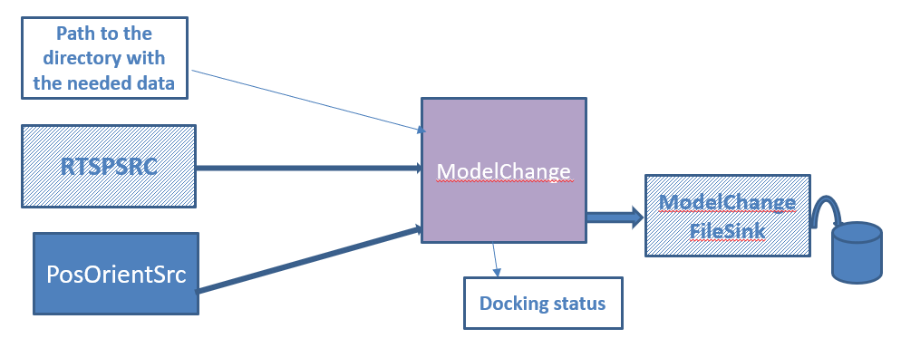
Display model changes pipeline
Pipeline details:
PosOrientSrc Plugin: connects to the video and retrieves the metadata and serves it as follows: Timestamp, 6 dofs, Rate to determine
RTPSRC Plugin output the video with RTP.
Path to the directory with the needed data is a parameter inserted at pipeline creation
The model change FileSink plugin with the location of the path of the needed data will be used to save the file containing the model change
The way the docking status will be reported in not defined yet
The main plugin is the ModelChange one that gets a path for the needed data at creation and save the model changes in a model file

Slide 21
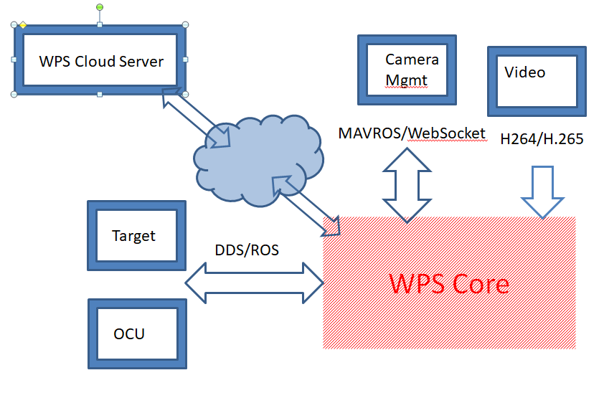
General Flow
Before drone’s flight:
User defines RoM on the map displayed by OCU
OCU sends to module that generates adequate WPs – Flight Plan
Flight plan reachs drone management station
User initiates flight and drone is on the air
User configures WPS mission
If mission is:
build sparse model: when the drone enters RoM, algo module of WPS core starts building sparse model
6/4/2020
- 21 -

